Slide 1
Vulcan Activity Tracker
CMSC-4920-Senior Project 2
Group2
Team: Margo Bonal, John Gerega, Luke Ruffing

Slide 2
Project Description
The Vulcan Activity Tracker is an athletic app that allows for the tracking of all campus athletics activities.
In one combined platform, the Vulcan Activity Tracker aspires to meet student organization needs, social interaction, and exercise goal planning in a free accessible way!

Slide 3
Weekly Progress
GOALS
Finalize Components
Debugging
Hosting Progress
Teams Page Progress
Invites
Announcements
Schedule
Leaderboard
Clubs Page Progress

Slide 4
Challenges
Solutions
Users could like their own activities in a clubs recent activities tab.
Coach is included in the team leaderboard. The leaderboard would mainly focus on athletes so we need to remove the coach
Teams page invites members via username. Coaches have access to all athlete emails so this would be more efficient
We made a backend check to stop this from happening, and disabled the like button for a users own activities on the front end.
Not fixed yet, but will be a simple solution as we will just remove members with the role of coach in the team
Also not fixed, but would simply just be a query for the user’s email instead of the username

Slide 5
Hosting
Platforms Attempted:
Render (Free & Paid) → MSSQL container failed to start
Azure Container Apps → Resource limits, container failures
Local Docker → Worked (Intel), failed on ARM/cloud
Key Issues:
MSSQL not supported in multi-container free/student tiers
Startup timing failures (“SQL Server never became ready”)
Architecture conflicts (amd64 vs arm64)
Environment variables unusable without DB container
Constraints:
Cannot change MSSQL schema (SQL Server–dependent project)
Conclusion:
PaaS platforms not viable for this architecture
Best Solution: VPS deployment or Azure SQL + Render

Slide 6
Progress
Vulcan Platform
Database

Slide 7

Teams Page

Slide 8
Live Hosting Demo

Slide 9
Week 13 Plan
Finalize more Components
Continue Debugging
Prepare Final Presentation
Finish Users Manual

Slide 10
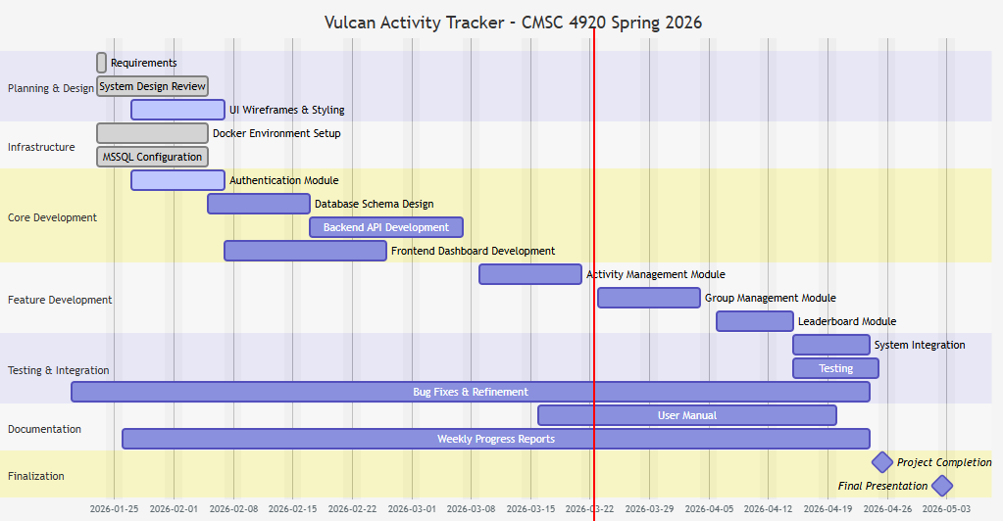
Planning
Gant chart

Slide 11
Website: https://jjdeuce06.github.io/VulcanActivityTracker/

